Slide 1

AI BASED SMART CAREER COUNSELLING
~AN OVERVIEW
S.PRINCE RAJ
D.SATHISH KUMAR B.SRI GANESH

Slide 2
Proposed Ideas
To Recommend a suitable career for the students based on Aptitude Tests and previous marks. To create a Chatbot and make it interact with students through which his/her careers are predicted and refined. To have real-time career insights and provide career suggestions based on it.

Slide 3


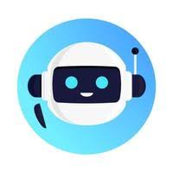

Use cases
Students will receive a report that explains their aptitude test results and provides suggestions for careers that are a good fit for them.
Real time career insights and providing career suggestions based on it.
The student then chats with a chatbot to discuss their results and explore different career options.
The student uses the information to make their career choices and make a decision about their future.

Slide 4
Flow chart of System Design(Backend) for analysis of Interest and marks of the students
Extraction of Marks
Supervised Learning Algorithm
Dataset
combine
Extraction of other activities(Interest)
Unsupervised Learning
Algorithm
Output
combine
Feature Extraction(Provided real time career Insights)
Interaction with ChatBot

Slide 5
Technologies and Dependencies
Machine Learning and Data Analytics:
Machine learning libraries and frameworks like TensorFlow, PyTorch, or scikit-learn for building recommendation models.
Data analytics tools to process and analyze user data, such as Python's pandas and NumPy libraries.
Natural Language Processing (NLP):
NLP libraries and frameworks, like NLTK, or Hugging Face Transformers, for text analysis and understanding user input.
Pretrained language models for text generation, sentiment analysis, and entity recognition.

Slide 6
Technologies and Dependencies (contd.)
Hugging Face Transformers:
Hugging Face's Transformers library is a state-of-the-art resource for working with transformer-based NLP models like BERT, GPT-2, and RoBERTa.
It offers pre-trained models, fine-tuning capabilities, and easy integration with popular deep learning frameworks.
Web Development:
Front-end web development technologies (HTML, CSS, JavaScript) for creating the user interface of the web app.
Back-end development technologies (e.g., Node.js, Python, Ruby on Rails) for server-side logic and API development.

Slide 7
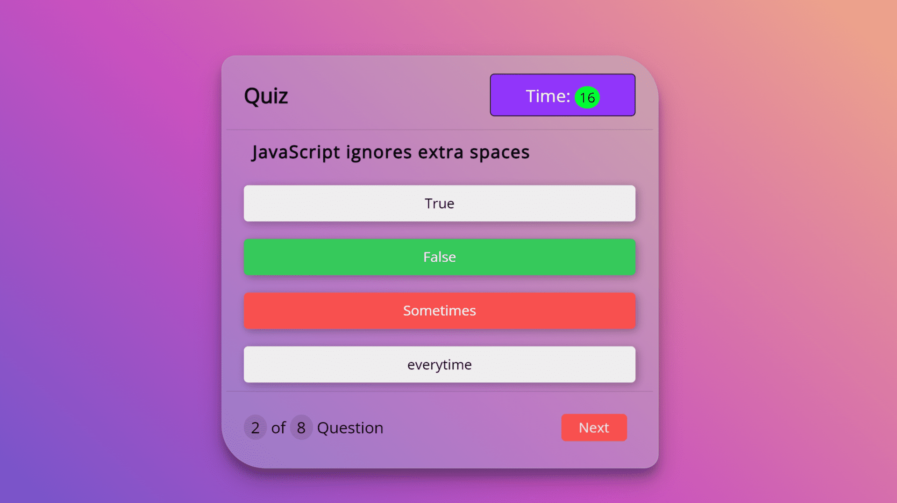
Prototype
Do you like to work with a team?
Yes
No

Slide 8
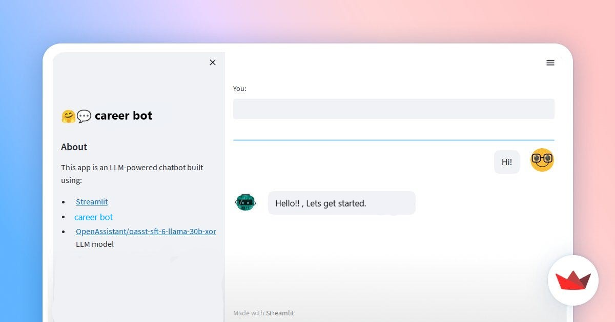
CAREER
BOT

Slide 9
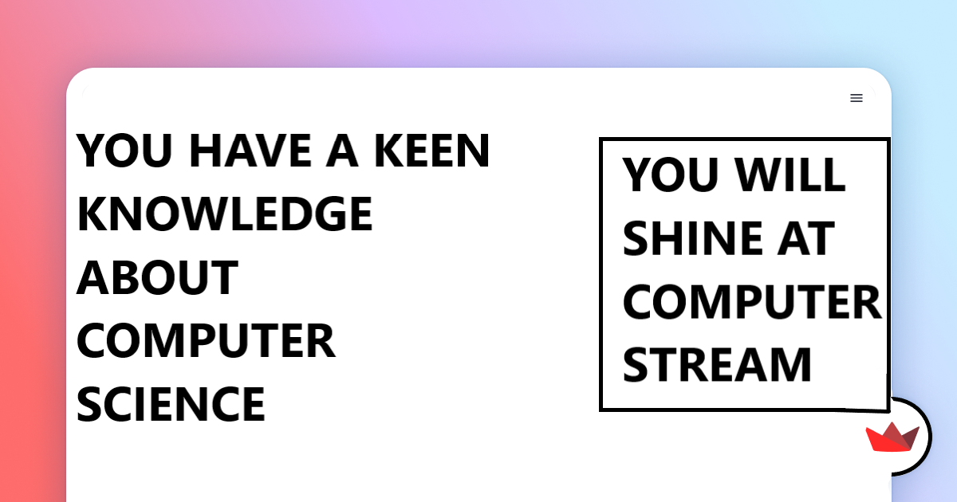
YEAH!!

Slide 10

Thank You!!!

